Slide 1


Analyzation of 'Smart Meters in London'
Authors:
Shevchenko Denys
Karabanov Yehor
https://github.com/LilConsul/PyEEPro

Slide 2
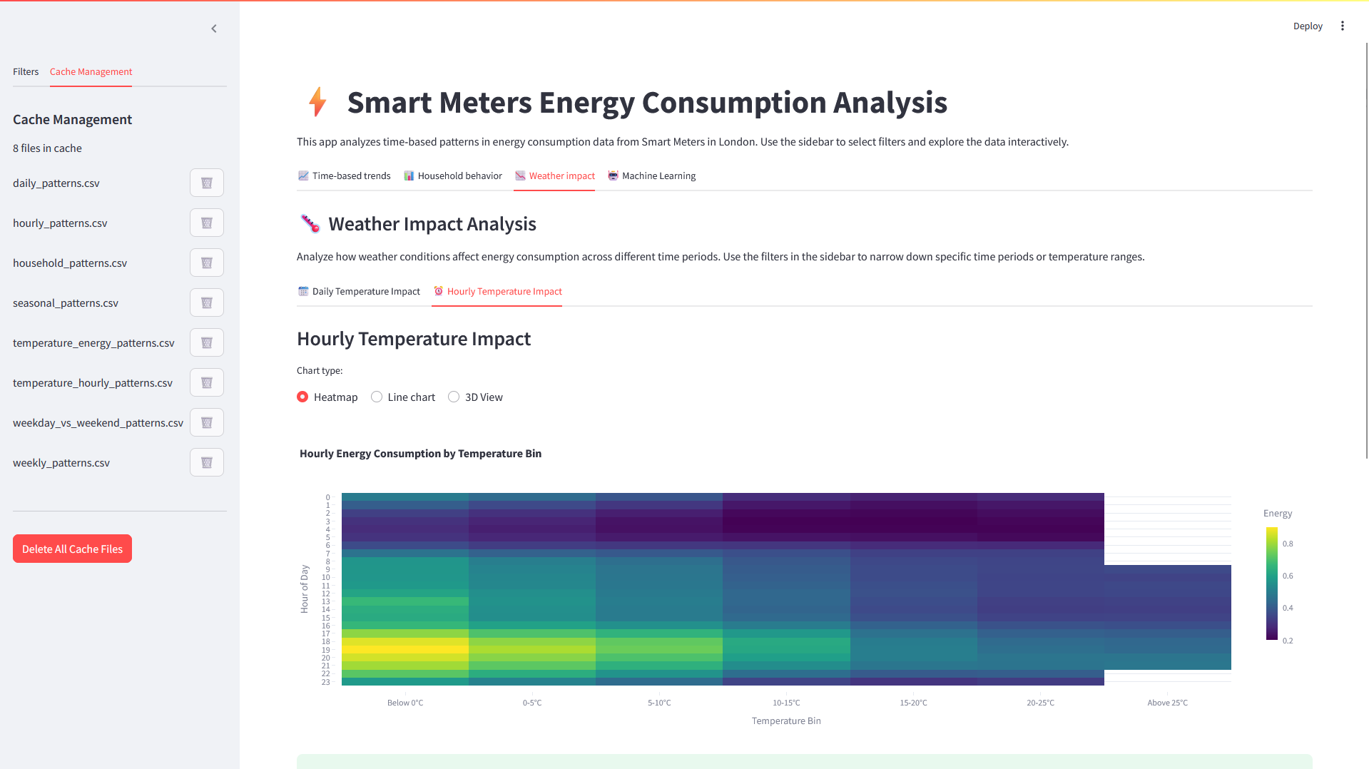
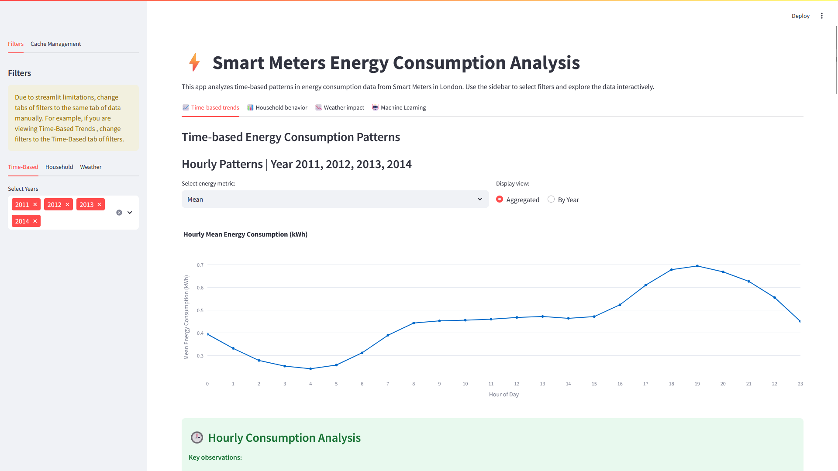
What We Built
We created an interactive dashboard that transforms London's smart meter data into actionable insights. Think of it as a detective tool for energy consumption – helping utility companies, city planners, and Londoners understand when, why, and how London uses electricity.
The dashboard reveals the rhythm of city life through energy patterns, turning millions of readings into stories that actually matter.

Slide 3


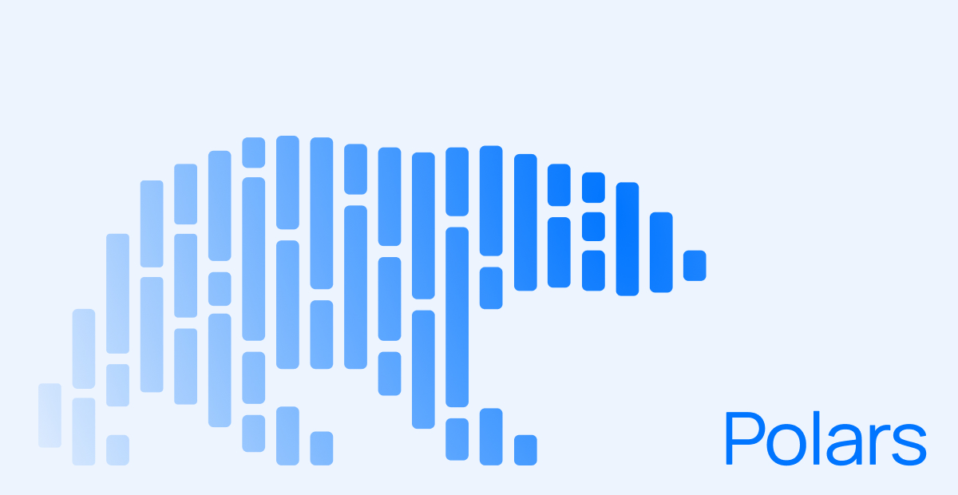
Our Approach
We combined powerful tools for maximum impact. Polars using rust processes data 10x faster than Pandas, while Streamlit creates an intuitive interface without months of development time.
Our analysis covers four key areas: daily and seasonal energy patterns, demographic influences on consumption, weather impacts, and smart anomaly detection using AI.

Slide 4
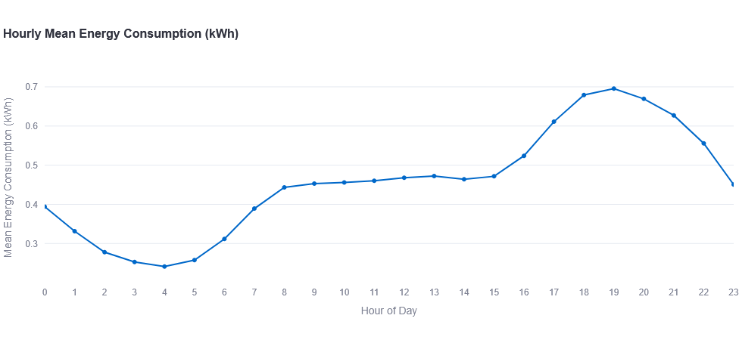
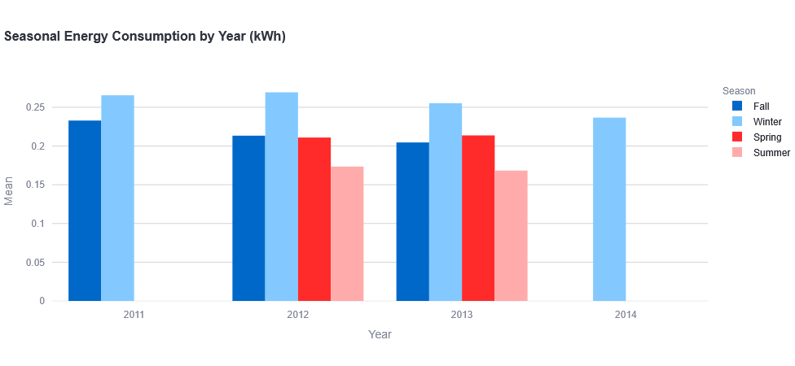
Daily Life Through Energy Data
The data tells London's story beautifully. Every morning between 7-9 AM, energy spikes as the city wakes up and gets ready for work. Another surge hits 5-8 PM when everyone comes home and starts cooking dinner.
Winter months show 20-30% higher consumption than summer, with the coldest periods hitting peak usage.
In weekends overall consumption is higher

Slide 5
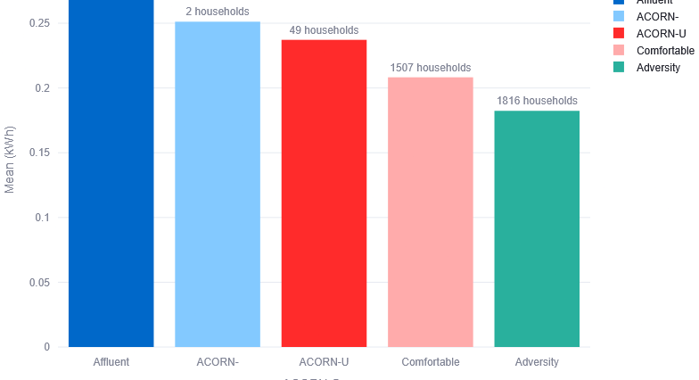
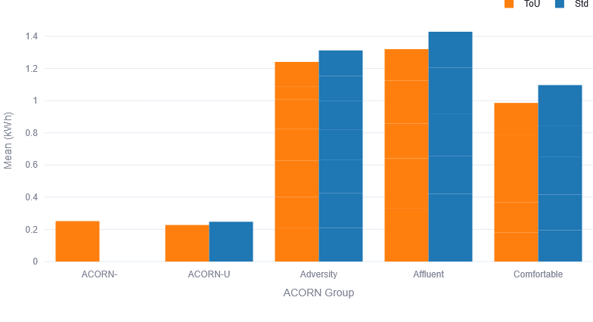
Demographics Drive Energy Patterns
ACORN demographic groups show dramatic consumption differences. Affluent households (Groups A-E) consume significantly more energy overall but show lower price sensitivity to Time-of-Use tariffs. Adversity groups (K-Q) demonstrate much lower baseline consumption while representing the second-largest household segment.
Tariff type creates behavioral splits – Time-of-Use customers consistently consume less across all demographic groups, with affluent segments showing the largest consumption differential between Standard and ToU tariffs, suggesting ToU pricing effectively encourages conservation even among high-usage households.

Slide 6
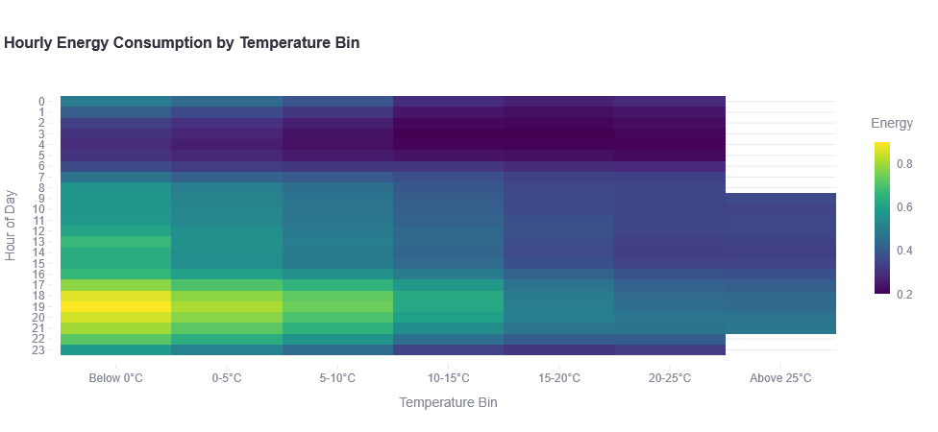
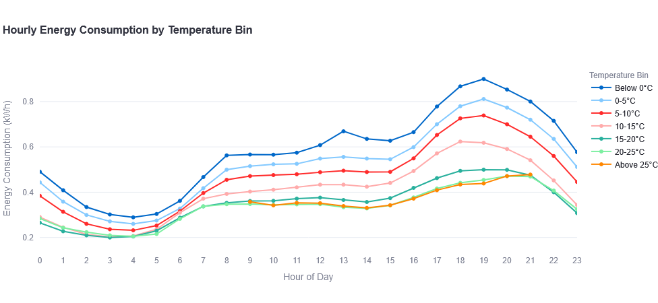
Weather's Hidden Impact
Temperature threshold effect: Below 5°C, each degree drop increases consumption by approximately 0.02-0.03 kWh per hour, with the effect amplified during peak hours
Evening peak intensity: The highest energy consumption occurs between 18:00-19:00 (6-7 PM), with below-freezing temperatures showing consumption spikes up to 0.90 kWh, compared to only 0.45-0.50 kWh during the same hours in the 15-20°C range

Slide 7
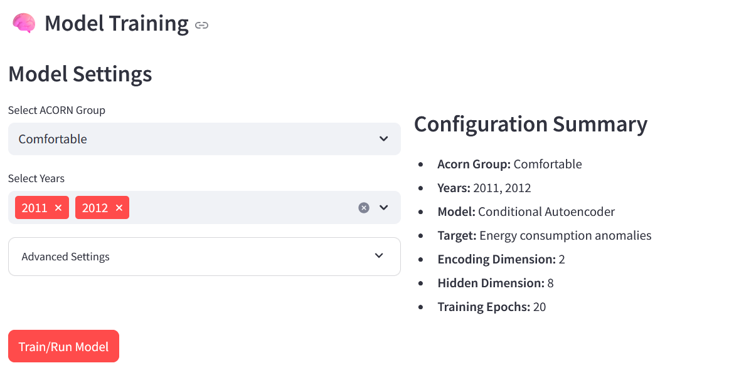
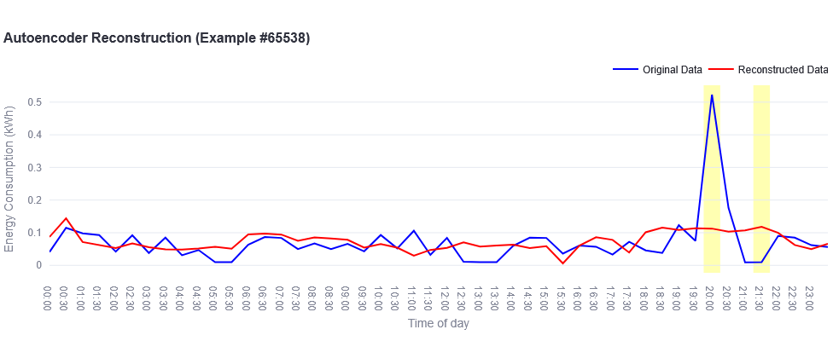
Smart Detection System
Our AI learns what "normal" looks like for each household and flags unusual patterns. This catches faulty appliances before they break, spots behavior changes, or identifies potential energy theft.
The system accounts for household types and external factors, so it doesn't flag every party or vacation as an anomaly.

Slide 8
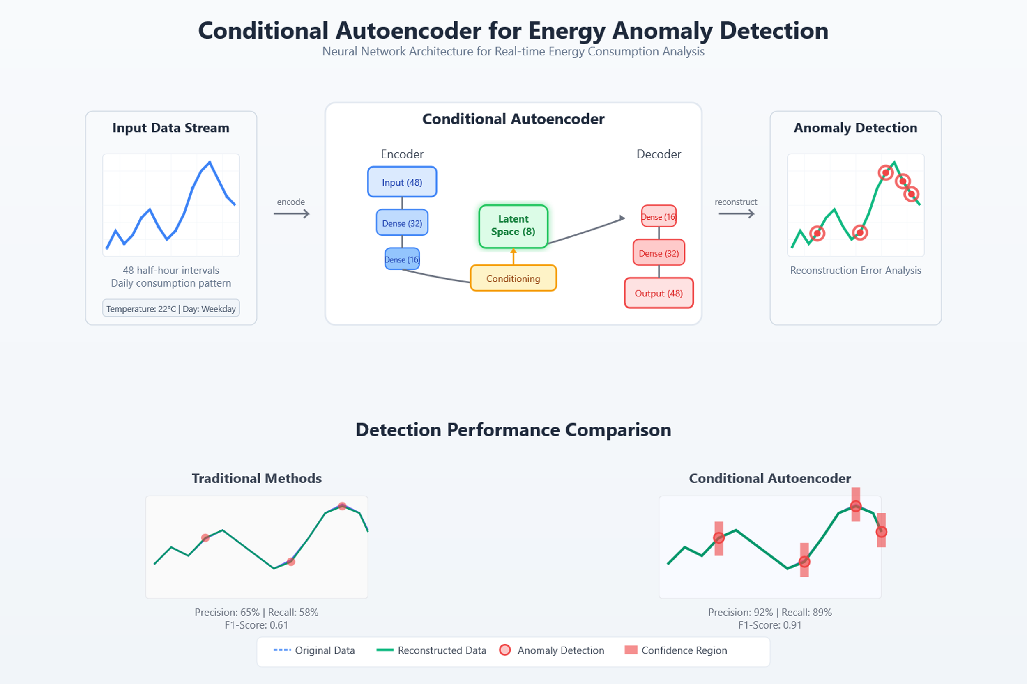
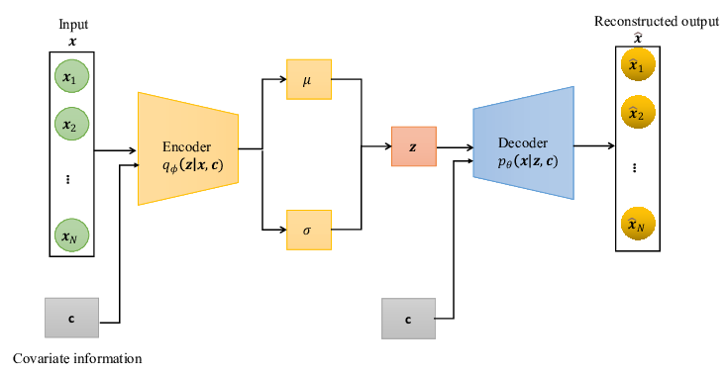
How our AI works
Our anomaly detection system uses a neural network architecture called an autoencoder that works in three key steps:
Learning Normal Patterns: The autoencoder first analyzes thousands of daily energy consumption profiles from households within the same demographic group.
Encoding-Decoding Process: It compresses each 48-point consumption pattern (representing half-hourly readings) into a compact 2-dimensional representation before reconstructing it. When patterns don't reconstruct well, they likely represent anomalies.
Context-Aware Detection: Our model incorporates household context (day of week, season, temperature) to distinguish between normal seasonal variations and true anomalies.
This approach enables early detection of unusual consumption patterns that may indicate appliance faults, energy theft, or significant behavior changes, with separate models tailored to each demographic group's unique usage profiles.

Slide 9
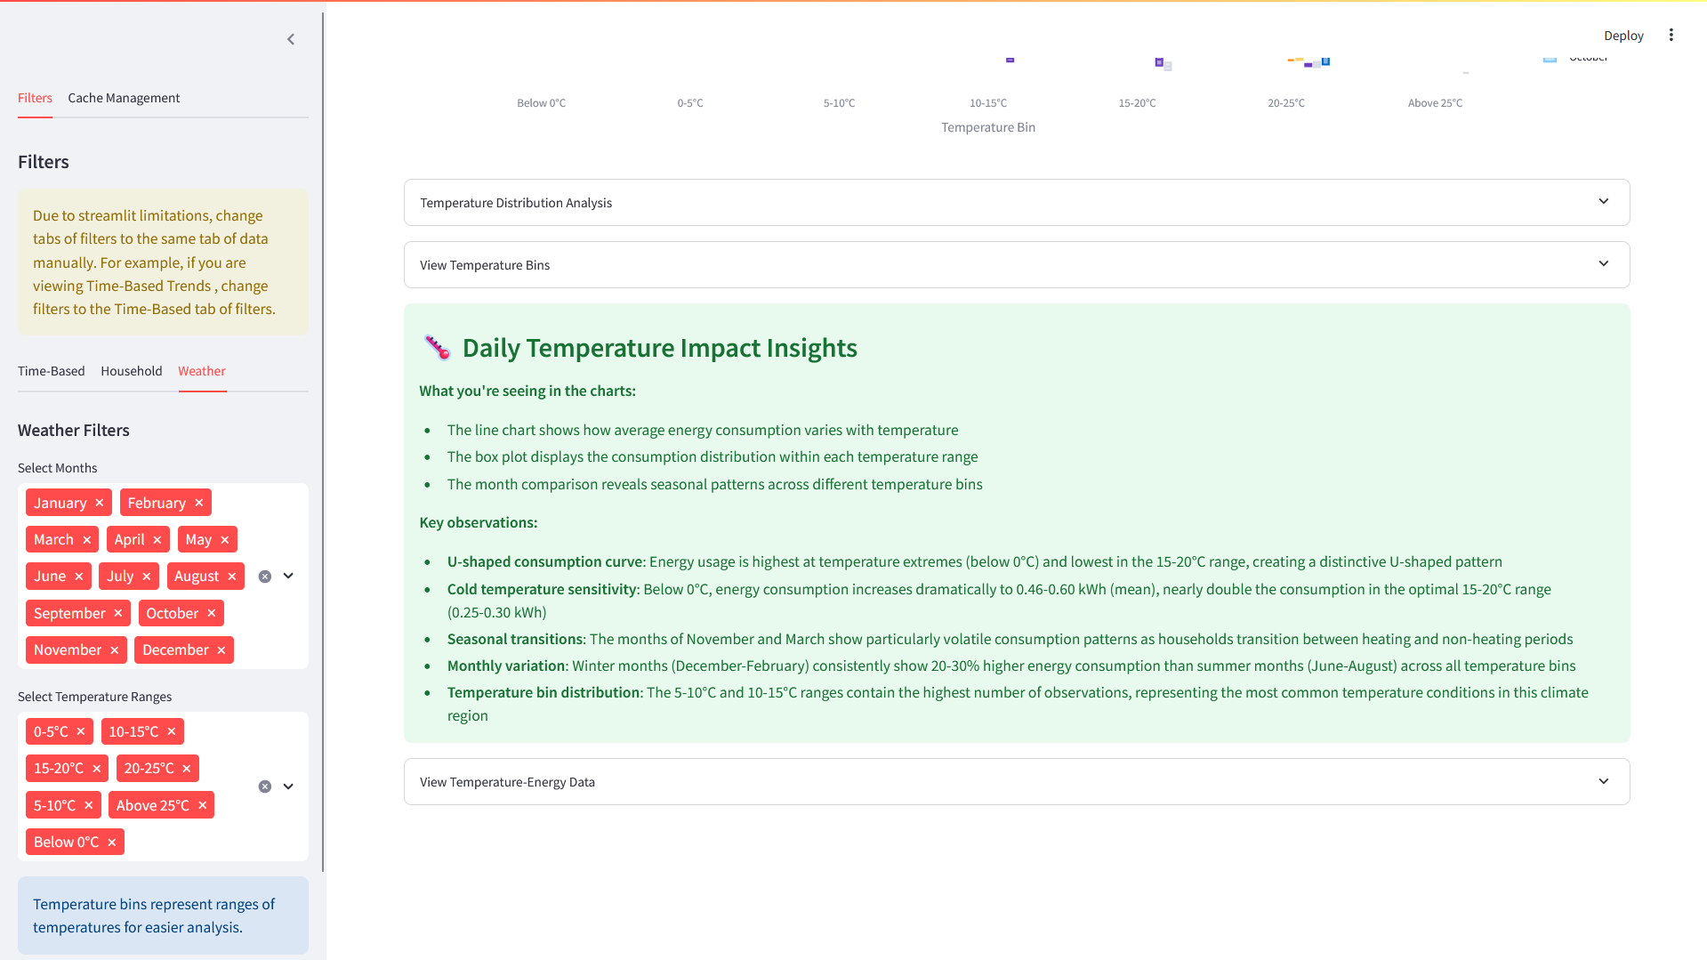
Technical Foundation
We prioritized speed and reliability. Our pipeline handles massive datasets quickly with smart caching for instant results. The machine learning components provide real-time insights while keeping the interface intuitive – no PhD required :). Every chart is explained how it works and what it shows. We also have “Interesting Insights” Section for each plot

Slide 10
Thanks for your time
To see project description visit GitHub readme file: https://github.com/LilConsul/PyEEPro
Report of the project is located inside of the ‘docs’ directory : https://github.com/LilConsul/PyEEPro/blob/main/docs/REPORT.md

